Slide 1
Casting impressions on plaster of Paris

Slide 2
Important things to note
Cover your nose and protect your face by wearing a face mask before proceeding to use it ,This is because plaster of Paris is a very fine powder and tends to fly.
Make sure that you break the lumps in the plaster of Paris powder with a spoon before you mix it with water so that you can mix it easily. The best way to do this is by adding the powder to the water rather than the other way around. Keep stirring with one hand even as you add the powder with the other hand bit by bit

Slide 3
Different typed of Plaster casting
Plaster of Paris Casting
Slip-Cast Forms
Gipson bandage technique
Leave plaster casting by direct method

Slide 4
Plaster of Paris Casting

Slide 5
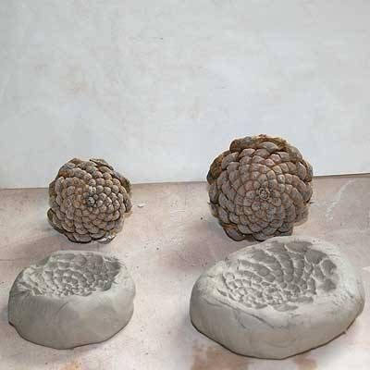
Slip-Cast Forms

Slide 6
Now a days a lot of preference is given to plaster casting
The kind of crafts that you will want to do will depend on your preference, but to start with we suggest that you use containers that are dispensable to start with. Like for instance, you can dip a blown balloon in plaster of Paris and let it dry before you burst the balloon to retrieve the container that you have created using this method. If you want to create hands, you can use rubber gloves that can be cut and thrown away to do this once the plaster of Paris that you filled in has dried out. Now take a look at the images we have given and get started on the kind of craft work you want to do.

Slide 7
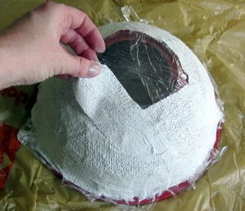
Gipson bandage technique

Slide 9
Direct method

Slide 10
Leave plaster casting
By pouring plaster directly on to the leave .

Slide 11
Indirect method

Slide 13
Indirect method
First of all select materials whose impression is required.
Carefully place your desired objects at the precise place for impression. To avoide double impression.
Now remove objects after pressing it hard to clay which is now serving as mold.
Finally pour out your plaster to the imprisoned mold

Slide 14
How to Pour Plaster of Paris
Keep tapping the side of the bowl to ensure that air bubbles do not form before you start mixing the powder. Once the mixture is ready, let it rest for a moment or two before you pour it into the mold that you will be using. If you want to introduce a color element at this stage, you can add a few drops of acrylic color at this stage and mix it before casting in the shapes that you wish the plaster to take.

Slide 16
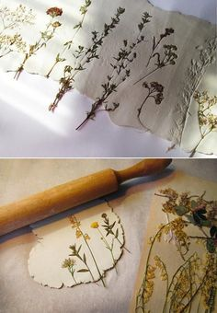
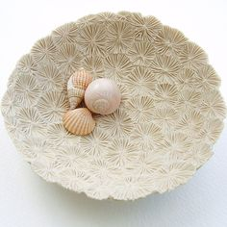

Slide 17
This idea can be done on clay as well

Slide 18
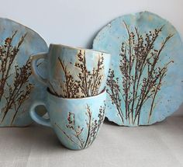
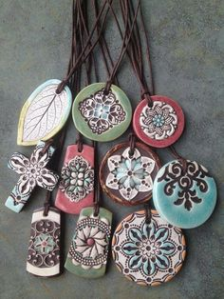
Ideas for various products

